Slide 1
HIV Treatment Outcomes Analysis and Prediction
Proposed title: Predicting HIV Treatment Outcomes Using Machine Learning
Viral Load
Suppression Classification and CD4 Count Estimation
Presented by: Marsha Kiptoo & Lorna Kemboi
Program: Eldo Hub Data Analysis
Dataset period: 2020–2025

Slide 2
Project Overview
This project uses patient data to explore HIV treatment outcomes and apply machine learning to predict important clinical indicators.
Project focus
1. Exploratory Data Analysis
Identify patterns, trends and relationships in patient characteristics and treatment outcomes.
2. Machine Learning
Classify viral load suppression status and estimate CD4 counts using patient information.
3. Web Application Deployment
Develop a Flask application to demonstrate the models' predictions from user-entered patient details.

Slide 3
Problem Statement and Objectives
Problem Statement
HIV treatment programs collect patient data, including viral load, CD4 counts, adherence and clinic attendance. Analyzing these data can help reveal patterns in treatment outcomes and identify factors associated with viral load suppression.
Project Objectives
Clean and prepare the dataset for reliable analysis.
Explore patient characteristics and HIV treatment outcome trends.
Build a classification model to predict viral load suppression status.
Develop a regression model to estimate CD4 counts.
Deploy the models in a Flask web application.

Slide 4
Dataset Overview
Dataset Description
The project uses a patient-level HIV treatment dataset containing demographic information, clinical indicators, treatment details and clinic attendance records.
5,200
Patient records
2020–2025
Registration period
Key Variables
Demographics: Age, Gender, Marital Status, Subcounty
Treatment: ART Status, Regimen Line, Adherence Level
Clinical indicators: CD4Count, ViralLoad__Last12Months

Slide 5
Data Cleaning and Preparation
Why was data cleaning necessary?
The dataset contained inconsistencies that needed to be addressed before exploratory analysis and machine learning.
Key data quality issues and actions
Inconsistent categories
Standardized Gender values, such as F, Female and FEMALE, into consistent categories.
Inconsistent date formats
Parsed Registration Date values into a consistent datetime format.
Missing values
Examined missing values and handled them according to the project's cleaning guidelines.
Data integrity checks
Checked CaseID values for missing entries and duplicates.

Slide 6
Exploratory Data Analysis
Purpose of EDA
To understand the characteristics of the patients and explore patterns in HIV treatment outcomes.
Treatment outcome patterns
Examined viral load suppression categories and relationships between selected patient variables and outcomes

Slide 7
Feature Engineering & Model Preparation
Preparing the data for machine learning
Cleaned dataset
Select relevant features and target variables
Classification Regression
Predict viral load suppression status Estimate CD4 count

Slide 8
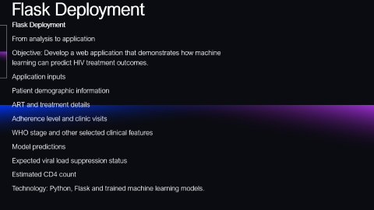
Flask Deployment
Flask Deployment
From analysis to application
Objective: Develop a web application that demonstrates how machine learning can predict HIV treatment outcomes.
Application inputs
Patient demographic information
ART and treatment details
Adherence level and clinic visits
WHO stage and other selected clinical features
Model predictions
Expected viral load suppression status
Estimated CD4 count
Technology: Python, Flask and trained machine learning models.

Slide 9
Machine Learning Approach
Machine Learning Models
Classification
Target: Viral load suppression status
Models tested: use the actual model names from your notebook.
Regression
Target: CD4 count
Models tested: use the actual model names from your notebook.
Visual: two columns showing the models used for each task, without repeating the preparation workflow.

Slide 10
Model Evaluation and Results
Classification
87.90%
Test accuracy — Random Forest
Regression
To verify
CD4 count estimation metrics
Evaluation metrics
Classification: accuracy, precision, recall, F1-score and confusion matrix, where available.
Regression: MAE, RMSE and \(R^2\), where available.
The classification accuracy is based on the result previously discussed

